Slide 1
Codes
BCD (Binary Coded Decimal)
Addition on BCD
Gray Code
Parity Code
Two-out-of-five Code
Aiken Code
Alphanumeric Codes

Slide 2
Codes
Some examples of data we use in our daily life are numbers, texts, pictures, videos, etc. But digital systems are based on only 0 and 1. The process of converting data to digital systems is called encoding.
There are two types of codes: Numeric and Alphanumeric codes.
There are two types of numeric codes: The ones which are based on weights of digits, and the ones which aren’t.
Most widely used alphanumeric codes are ASCII, Extended ASCII, EBCDIC and UNICODE.

Slide 3
BCD (Binary Coded Decimal)
In BCD code, each decimal digit is converted to a 4-bit binary number. We convert each decimal digit separately. The weights of this 4-bit binary number are 2³-2²-2¹-2⁰ (8-4-2-1) respectively. This code is also known as 8421 code.
Example: Let’s convert 25₁₀ to BCD.
2 5
0010 0101 So, 25₁₀ = 00100101_{BCD}

Slide 4
BCD Addition
Since each bit have a weight, we can do arithmetic operations on BCD.
We do BCD addition regarding three rules below.
We do BCD addition the same way as binary addition.
If the sum of two 4-bit groups is less than or equal to 9, then the result is valid.
If the sum is greater than 9 or we have a carry bit, then the result is invalid. In this case, we add 6 (0110)₂ to the sum. The new sum is valid even if we have a carry bit after adding 6.

Slide 5
BCD Addition
Example: Let’s do 8₁₀ + 4₁₀ in BCD.
8₁₀ = 1000_{BCD} 1000_{BCD}
4₁₀ = 0100_{BCD} + 0100_{BCD}
1100_{BCD} + 0110_{BCD}
0001 0010_{BCD}
Example: Let’s do 39₁₀ + 97₁₀ in BCD.
39₁₀ = 0011 1001_{BCD} 1
97₁₀ = 1001 0111_{BCD} 0011 1001_{BCD}
+ 1001 0111_{BCD}
1101 0000
+ 0110 0110
0001 0011 0110_{BCD}
This number is greater than 9.
So we need to add 6 to fix it.
We have a carry bit, but it’s OK.
We need to add 6
Because it’s greater than 9.
We need to add 6
Because there’s a carry bit.

Slide 6
Gray Code
In Gray code, bits don’t have weights. Therefore, we can’t do arithmetic operations in Gray code. What makes gray code special is that only one bit changes when we increase a number by one. This code is mostly used for error-checking purposes.
Decimal | Binary | Gray
0 | 0000 | 0000
1 | 0001 | 0001
2 | 0010 | 0011
3 | 0011 | 0010
4 | 0100 | 0110
5 | 0101 | 0111
6 | 0110 | 0101
7 | 0111 | 0100
8 | 1000 | 1100
9 | 1001 | 1101

Slide 7
Gray Code
To convert from binary to Gray code, we take the MSB as it is. We calculate next Gray code bits by adding each two consequent bits. We ignore the carry bits if there are any.
Example: Let’s convert 101101₂ to Gray code.
1 + 0 + 1 + 1 + 0 + 1
1 1 1 0 1 1 So, 101101₂ = 111011_{Gray}
To convert from Gray code to binary, we take the MSB as it is. We calculate next bit of binary number by adding the binary MSB to the next Gray code bit. We calculate the next binary bit by adding the second-left bit of the binary number to the third-left bit of Gray code number. And it goes on by repeating the same process for next bits. We ignore the carry bits if there are any.
Example: Let’s convert 101101_{Gray} to binary.
1 0 1 1 0 1
1 1 0 1 1 0 So, 101101_{Gray} = 110110₂
+
+
+
+
+

Slide 8
Parity Code
Parity code is mostly used for checking the validity of data transfered. There are two types of parity code: Even parity, and odd parity. When we need to transfer 7-bit data, we can add an extra bit for error checking.
Assuming that we are using odd parity bit, we check if the number of 1’s are odd or even. If the number of 1’s is odd, then we add 0 as parity bit. If it is even, we add 1. Likewise, if we are using even parity bit, we add 0 if the number of 1’s is even, and 1 if it’s odd.
Example: Let’s code (1010001)₂ with odd parity.
The number of 1’s is 3, which is an odd number. Therefore, we need to add 0 as parity bit. So, encoded data would be 01010001₂.
Example: Let’s code (1010001)₂ with even parity.
The number of 1’s is 3, which is an odd number. Therefore, we need to add 1 as parity bit. So, encoded data would be 11010001₂.

Slide 9
Two-out-of-five Code
In 2-out-of-5 code, we represent each decimal digit with a 5-bit binary number which have two 1’s in it. This makes error checking easier. The weights of bits are ‘7-4-2-1-0’.
Digits | 2-out-of-5 code
 | 7 4 2 1 0
0 | 1 1 0 0 0
1 | 0 0 0 1 1
2 | 0 0 1 0 1
3 | 0 0 1 1 0
4 | 0 1 0 0 1
5 | 0 1 0 1 0
6 | 0 1 1 0 0
7 | 1 0 0 0 1
8 | 1 0 0 1 0
9 | 1 0 1 0 0

Slide 10
Aiken Code
In Aiken code, we represent each decimal digit with a 4-bit binary number. The weights of bits are ‘2-4-2-1’. Digits 0-4 start with 0, and 5-9 start with 1. Aiken code is example of symmetric codes.
Digit | Aiken Code 2 4 2 1
0 | 0 0 0 0
1 | 0 0 0 1
2 | 0 0 1 0
3 | 0 0 1 1
4 | 0 1 0 0
5 | 1 0 1 1
6 | 1 1 0 0
7 | 1 1 0 1
8 | 1 1 1 0
9 | 1 1 1 1

Slide 11
Alphanumeric Codes
In transmission, we need not only numbers, but also the letters, punctuation marks and other symbols. The most popular alphanumeric code is ASCII (American Standart Code for Information Interchange).
ASCII, is an alphanumeric code which is widely used in computers and other systems. For example, when we press a key on the keyboard, a numeric code that corresponds to that key is sent to the computer. This numeric code consists of 7-bits. 8th bit can be used for error checking. With 7 bits, we can represent different characters. First 32 characters are not displayed on the screen, but the rest can be displayed. We can also use ASCII code in transmission between computers and printers.

Slide 12
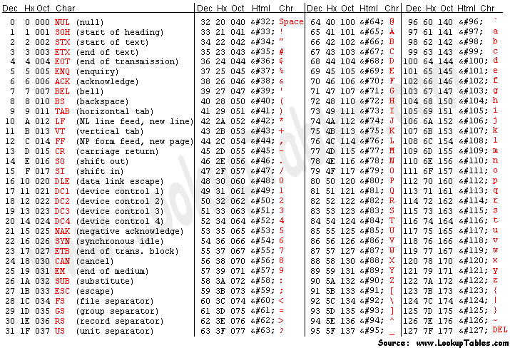
ASCII

